Slide 1
Train a Neural Network
Using Backpropagation

Slide 2
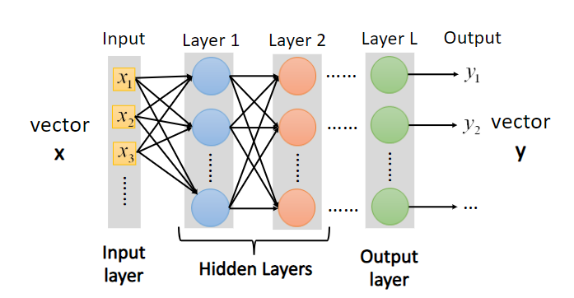
Artificial Neural Network -Structure
Deep Neural Network: Multiple hidden layers

Slide 3
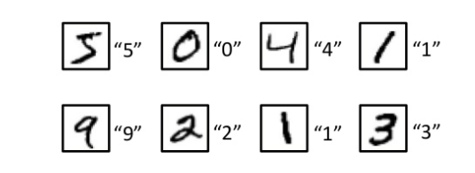
Training Data
Images and their labels

Slide 4
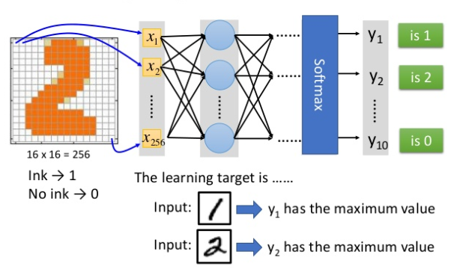
Learning Target

Slide 5
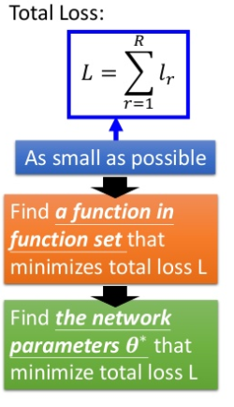
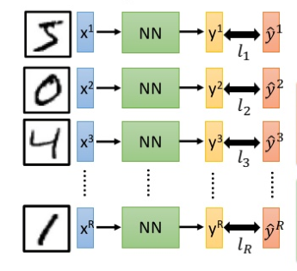
Total Loss
For all training data:
Learning

Slide 6
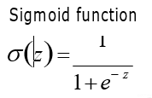
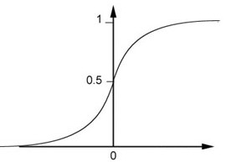
Artificial Neural Network -Neuron
Neuron
a1
.
.
.
W1
z
.
.
.
Z = 4
0.98
ak
Wk
+
σ
(z)
a
.
.
.
.
.
.
WK
Activation Function
Output
aK
Weights
b
Bias
Inputs

Slide 7
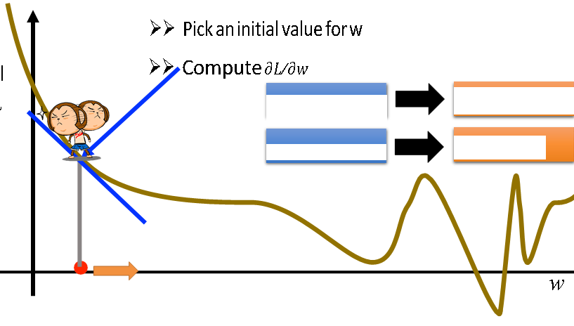

How to find the best function
Gradient Descent
Total Loss

Slide 8
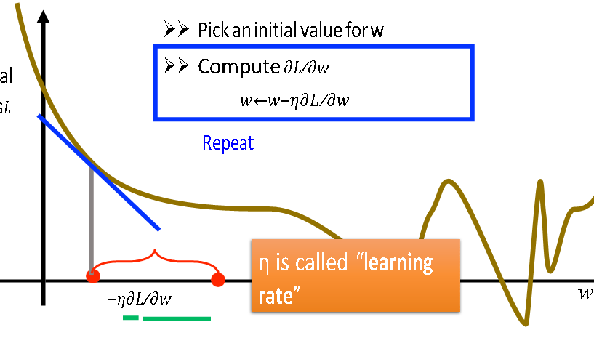
How to find the best function
Gradient Descent

Slide 9
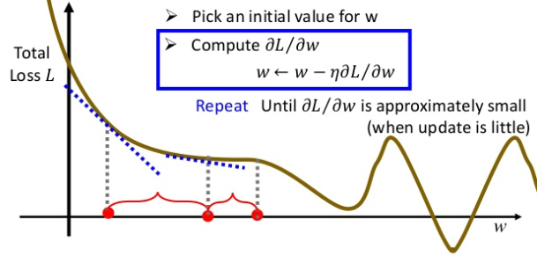
How to find the best function
Gradient Descent

Slide 10
Back propagation

Slide 11
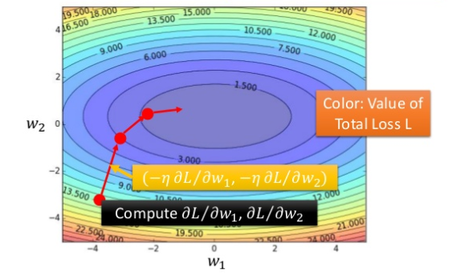
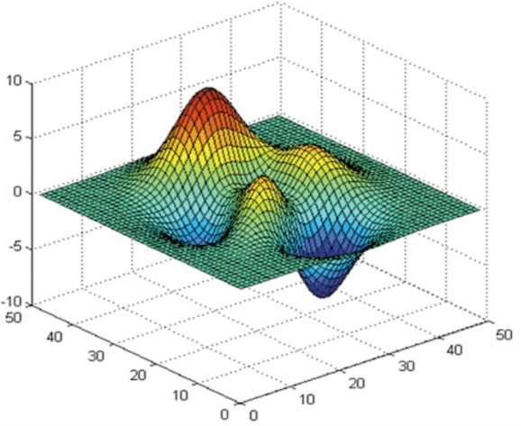
How to find the best parameters
This is the “learning” of machines in deep learning ……
Gradient Descent
But no guarantee:
Potential local minima issues with different initial points
Random start, hopefully we could reach the global minima

Slide 12
Local vs Global Optimal
Total Loss
A
B

Slide 13
How to unstuck and keep learning
Follow the momentum from previous steps
-> Adam optimizer for gradient descent
Total Loss
A
B

Slide 14
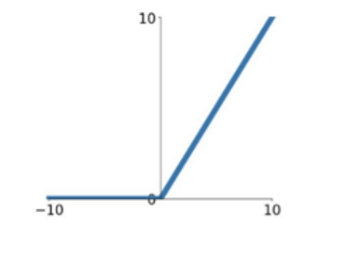
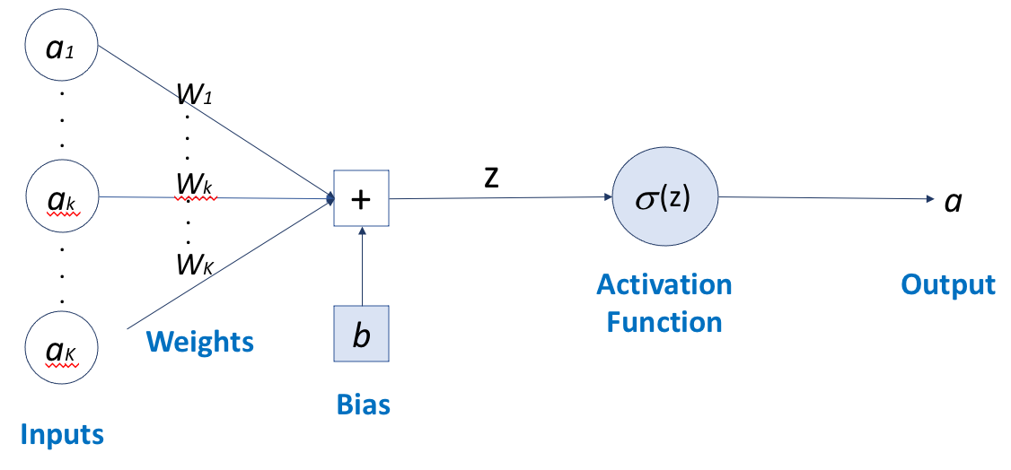
What determines a neural network’s performance
Structure of the neural network:
layers and connections
Activation function
Ex: ReLU or Sigmoid
Parameters (w and b)
back propagation using gradient descent

Slide 15
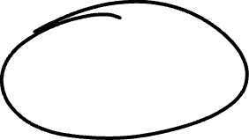
Nice videos on the concepts of Neural Nets
https://www.youtube.com/playlist?list=PLZHQObOWTQDNU6R1_67000Dx_ZCJB-3pi

